Slide 1
Lecture 6: Regression & Overfitting

Slide 2
Bias-variance tradeoff
Variance: Captures how much your classifier changes if you train on a different training set. How "over-specialized" is your classifier to a particular training set (“overfitting”)? If we have the best possible model for our training data, how far off are we from the average classifier?
Bias: What is the inherent error that you obtain from your classifier even with infinite training data? This is due to your classifier being "biased" to a particular kind of solution (e.g. linear classifier). In other words, bias is inherent to your model.

Slide 3
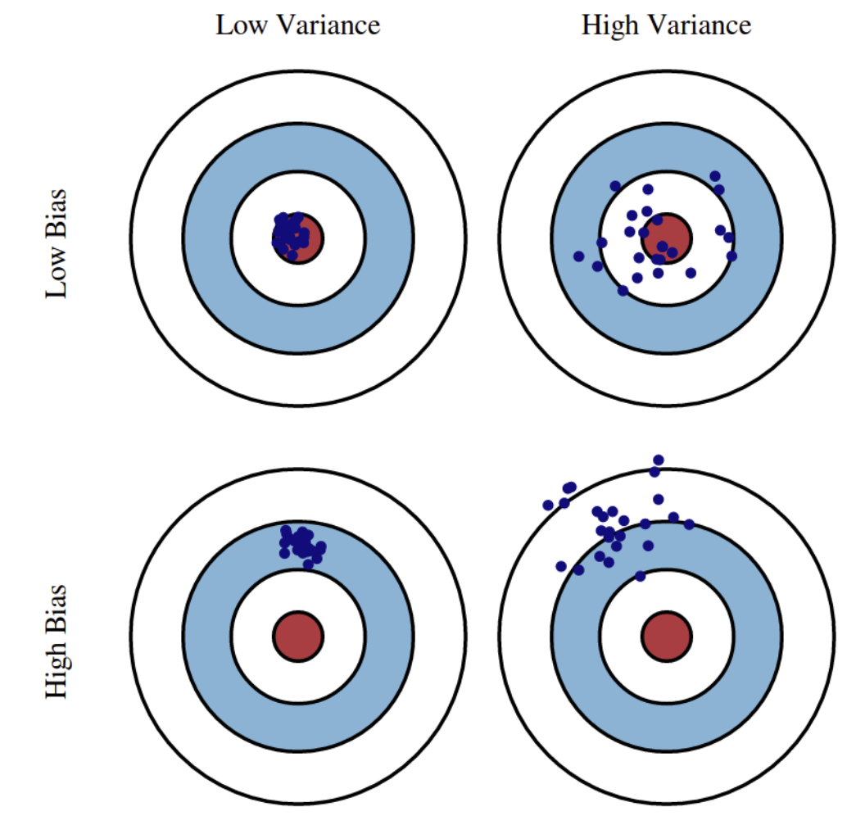
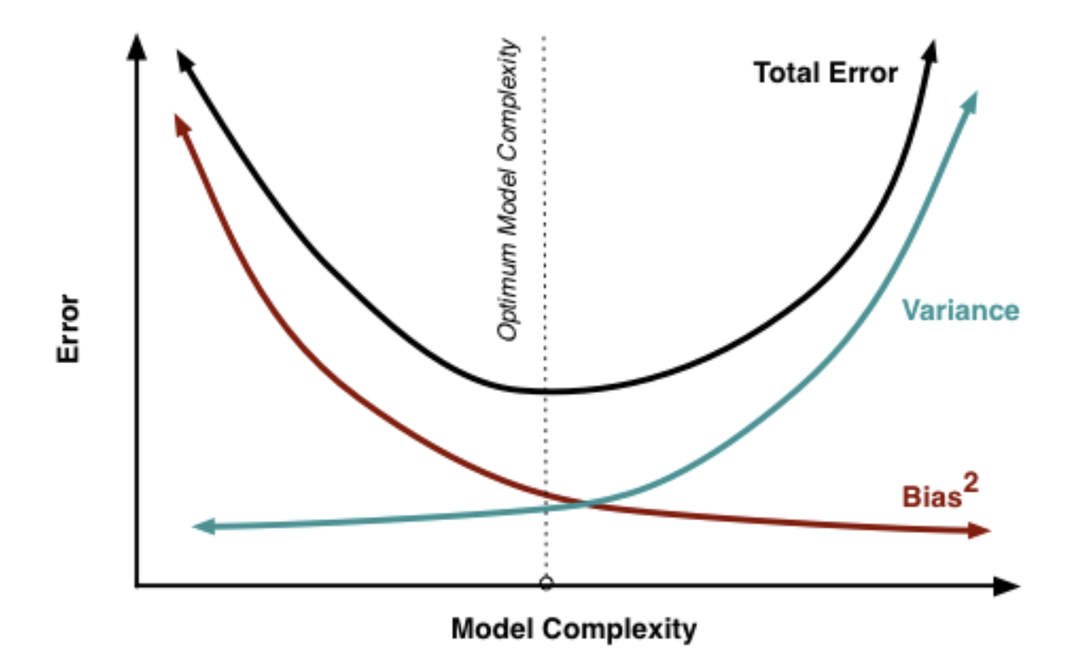
Bias-variance tradeoff

Slide 4
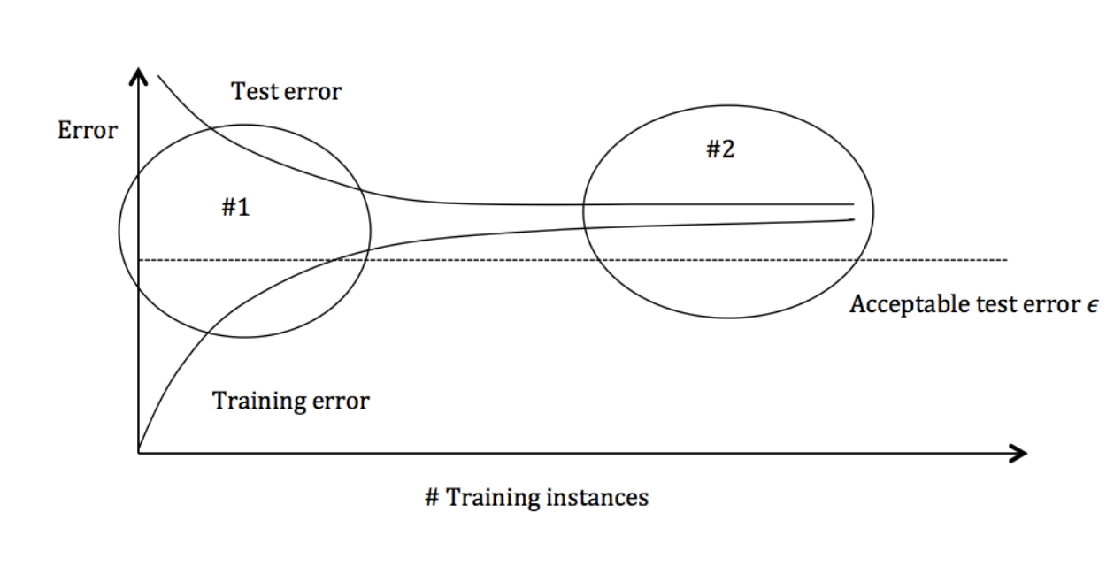
Bias-variance tradeoff

Slide 5
Bias-variance tradeoff
Scenario/plan/regime #1 (high variance):
  Variance: Captures how much your classifier changes if you train on a different training set. How "over-specialized" is your classifier to a particular training set (“overfitting”)? If we have the best possible model for our training data, how far off are we from the average classifier?

Slide 6
Bias-variance tradeoff
Scenario/plan/regime #1 (high variance):
  Symptoms:
    Training error is much lower than test error
    Training error is lower than ε
    Test error is greater than ε
  Remedies:
    Add more training data
    Reduce model complexity
    Bagging

Slide 7
Bias-variance tradeoff
Scenario/plan/regime #2 (high bias):
  Bias: What is the inherent error that you obtain from your classifier even with infinite training data? This is due to your classifier being "biased" to a particular kind of solution (e.g. linear classifier). In other words, bias is inherent to your model.

Slide 8
Bias-variance tradeoff
Scenario/plan/regime #2 (high bias):
  Symptoms (well, symptom):
    Training error is higher than ε
  Remedies:
    Use a more complex model (say, non-linear regression)
    Add features
    Boosting

Slide 9
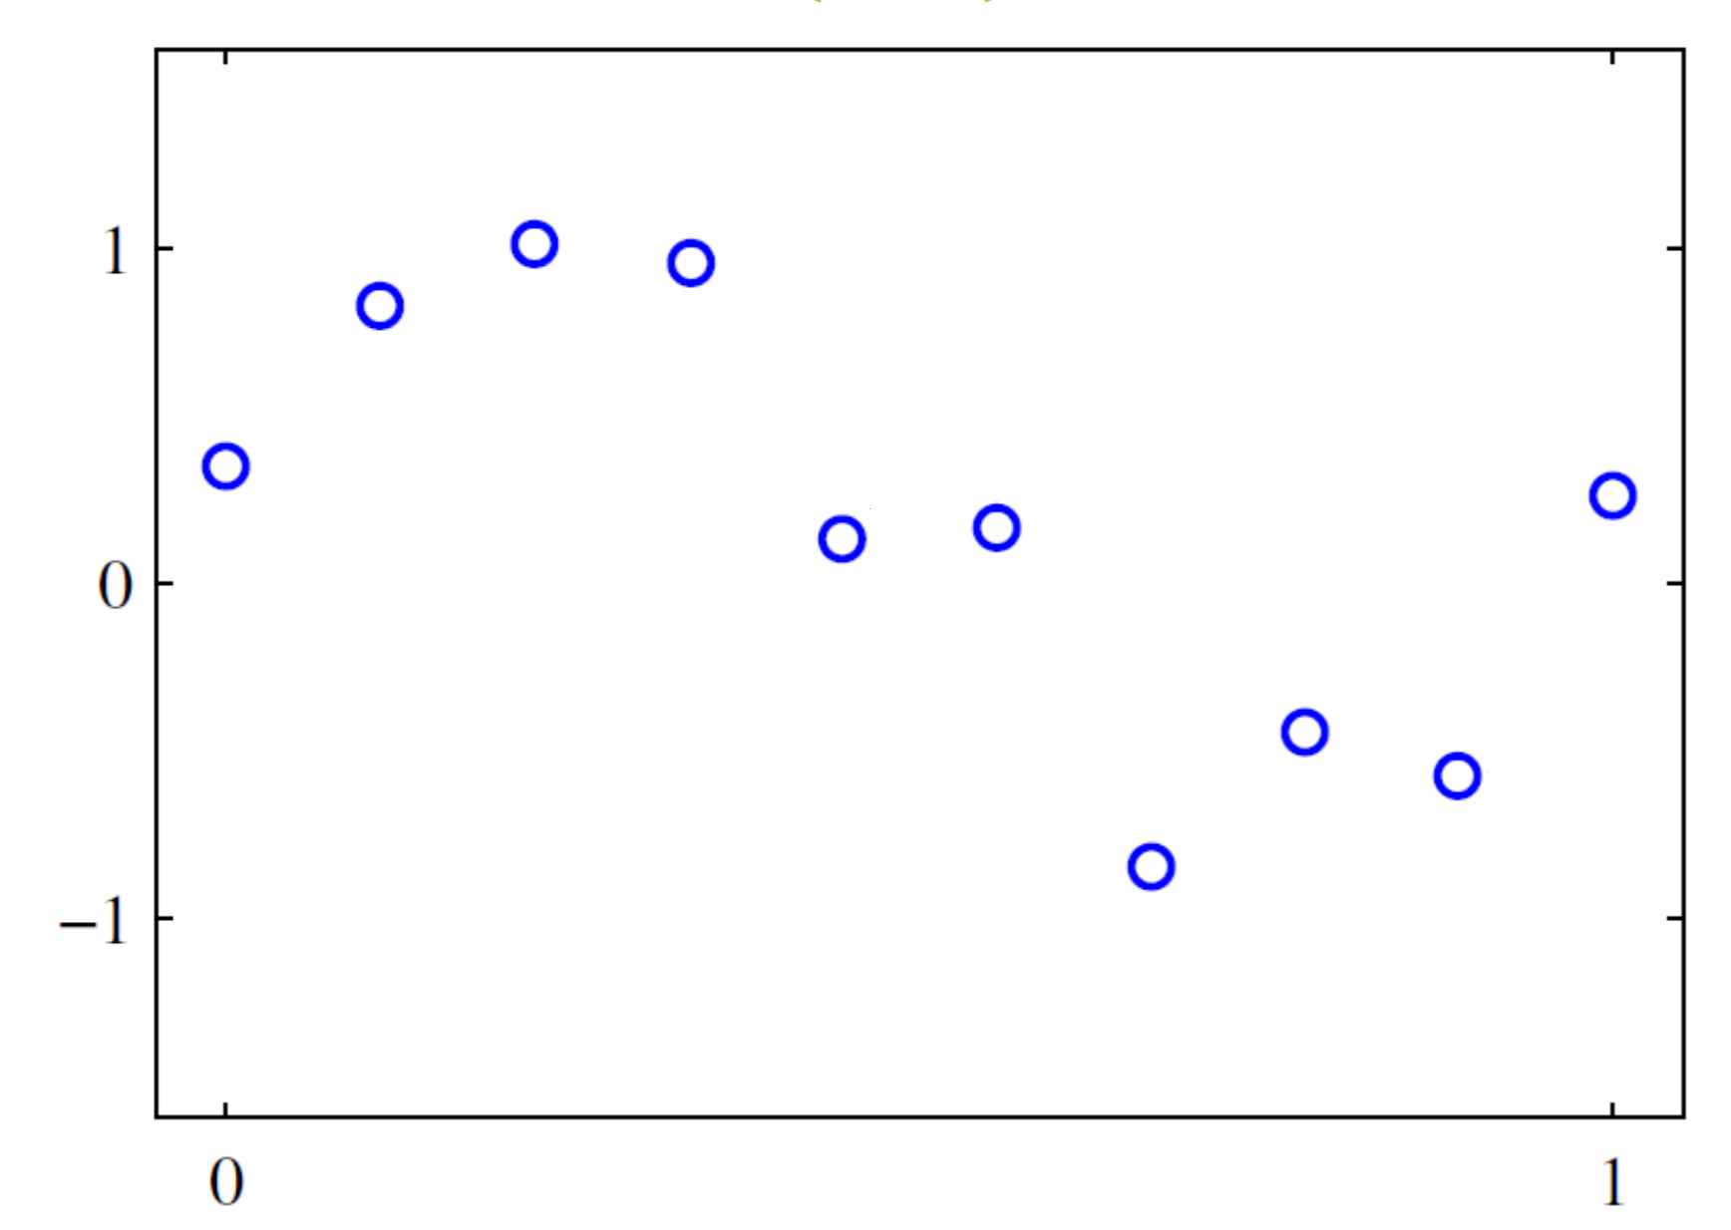
Overfitting
Say you have the following data…

Slide 10
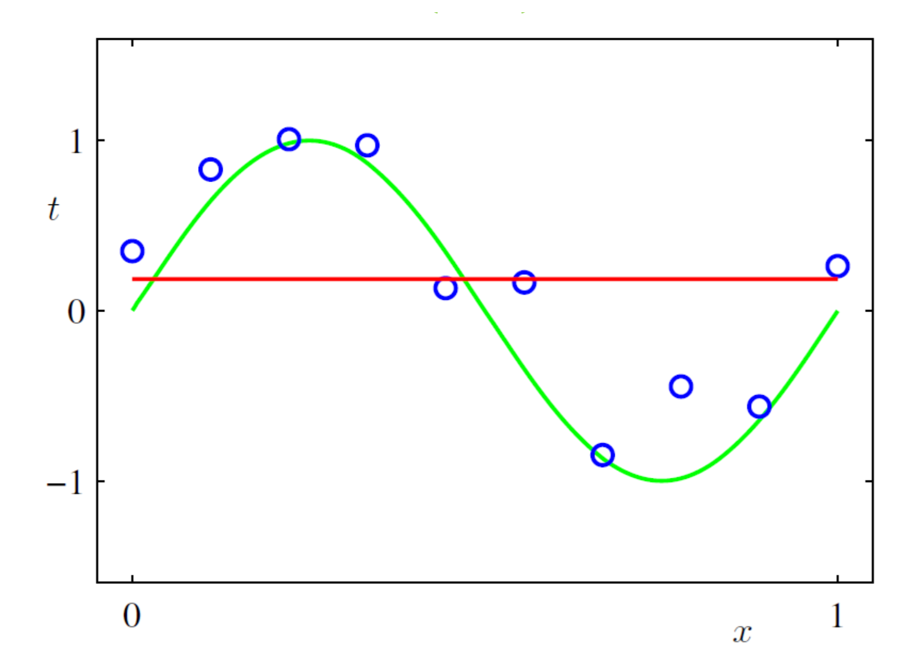
Overfitting
You could fit it like this (0 degree polynomial)…

Slide 11
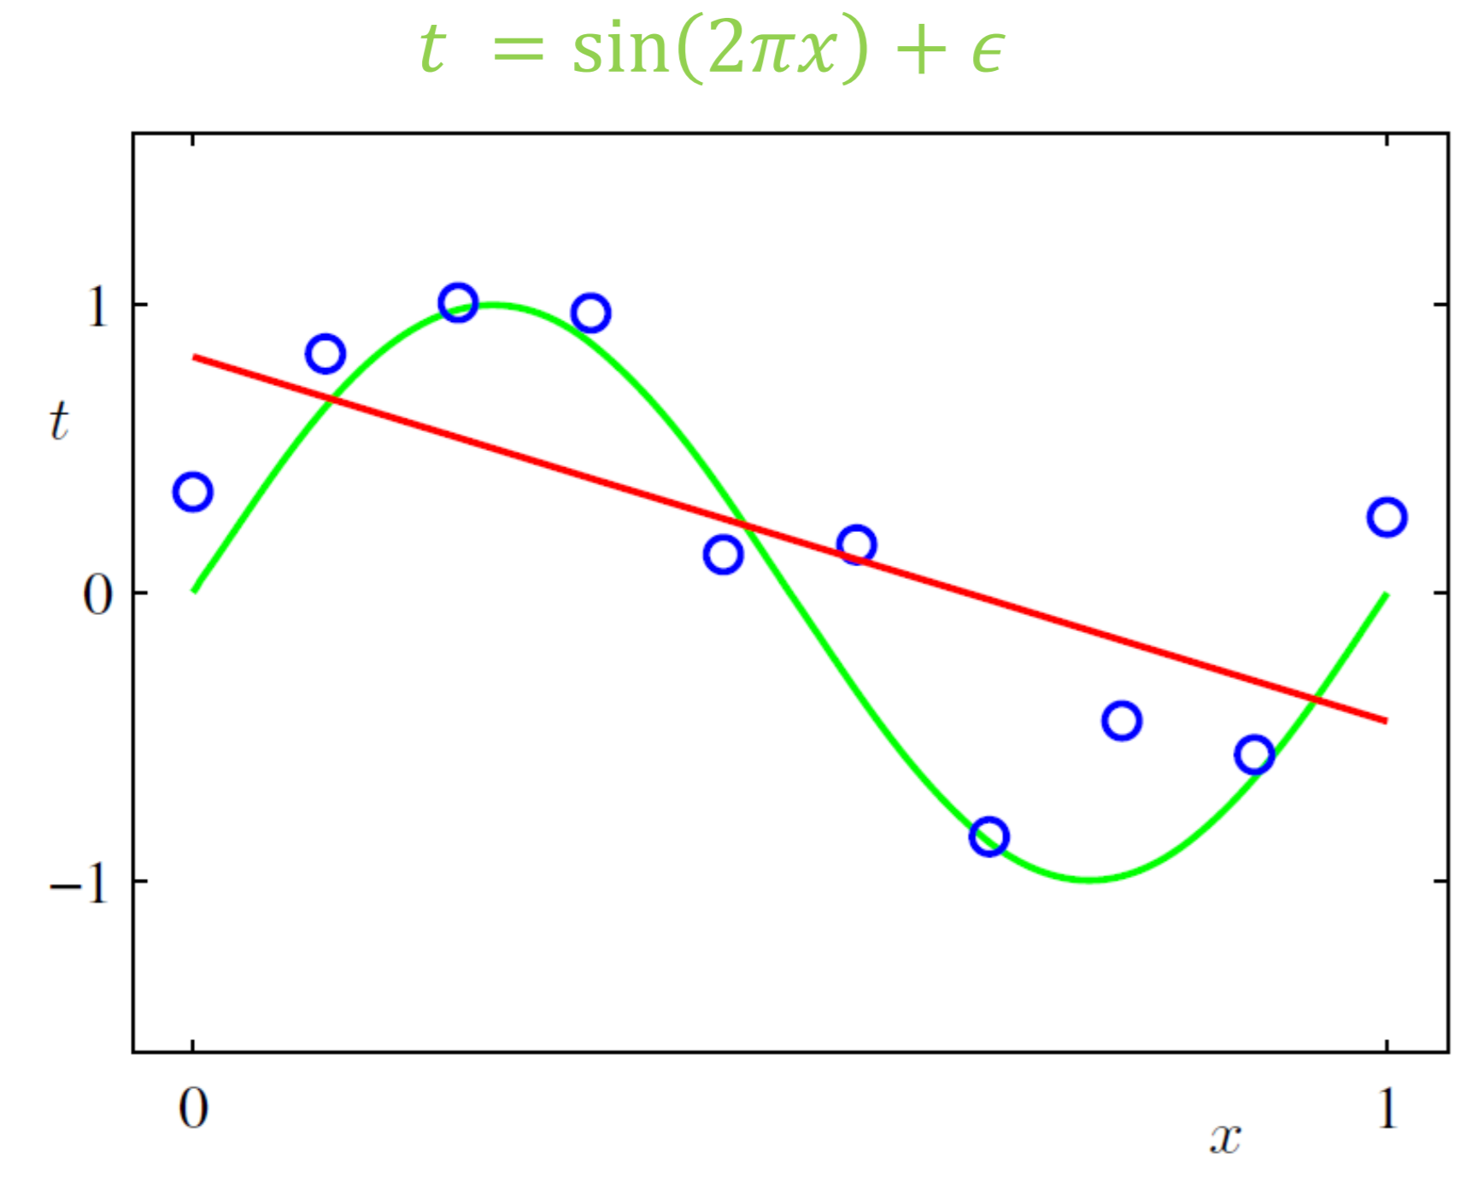
Overfitting
Or like this (1st)…

Slide 12
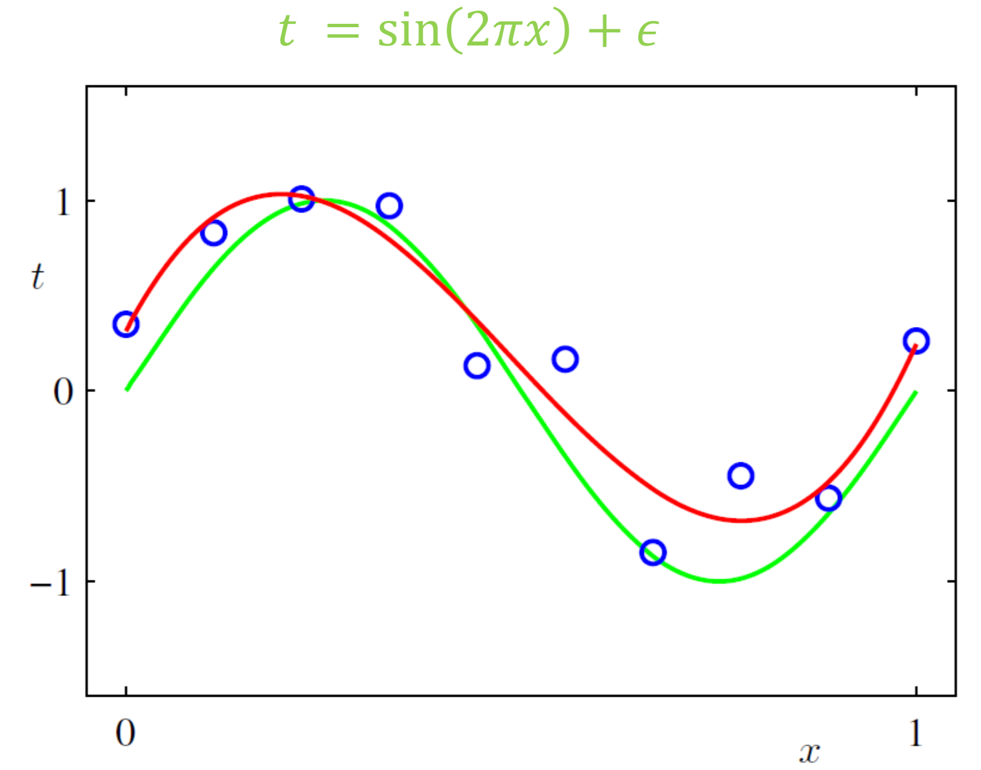
Overfitting
Or like this (3rd)…

Slide 13
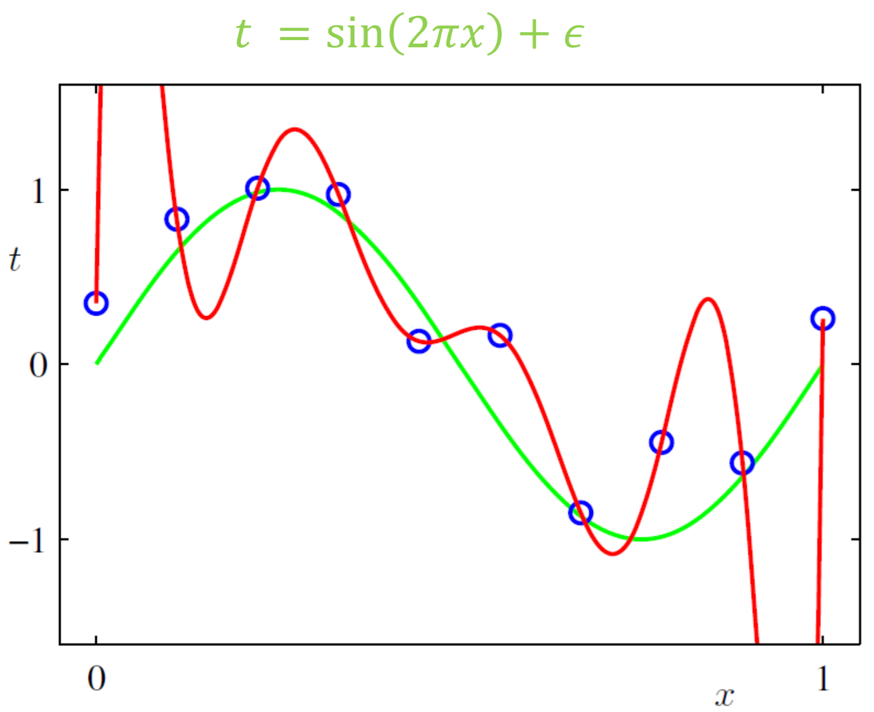
Overfitting
Or like this… (9th degree polynomial)

Slide 14
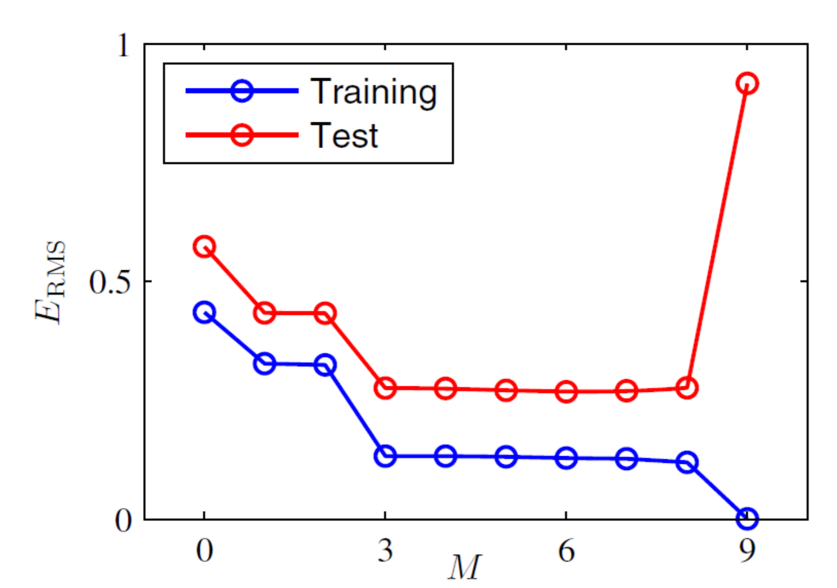
Error vs degree of polynomial

Slide 15
Recap
So, if you “fit” your training data too well (if you learn too much), you end up describing your training data very well, but at the cost of not describing your test data at all (“overfitting”)
The larger the training data, the less difference there tends to be between the training data and the test data (larger data set helps!)
The larger the hypothesis class (the more potential models that you allow), the easier it is to find a model that fits very well (and therefore predisposes you more to overfitting)

Slide 16
Too many possible models (hypotheses)?
The larger the hypothesis class (the more potential models that you allow), the easier it is to find a model that fits very well (and therefore predisposes you more to overfitting)
Therefore, it often is not best to just learn from the data as we did with MLE, but to incorporate prior knowledge, as we did with Bayesian inference
  But this can be overcome with more data! And is a good strategy if you have no reliable prior knowledge
  But throwing out useless hypotheses is always a good idea

Slide 17
Prior knowledge vs data?
Let’s start by looking at the extremes:
  “Perfect” prior knowledge – you don’t need data, your model is equal to the true underlying distribution
  “Perfect” data – you have infinite data, so your data is the underlying distribution
Practical scenarios: finite data, H, actual model function f* (you don’t know this)

Slide 18
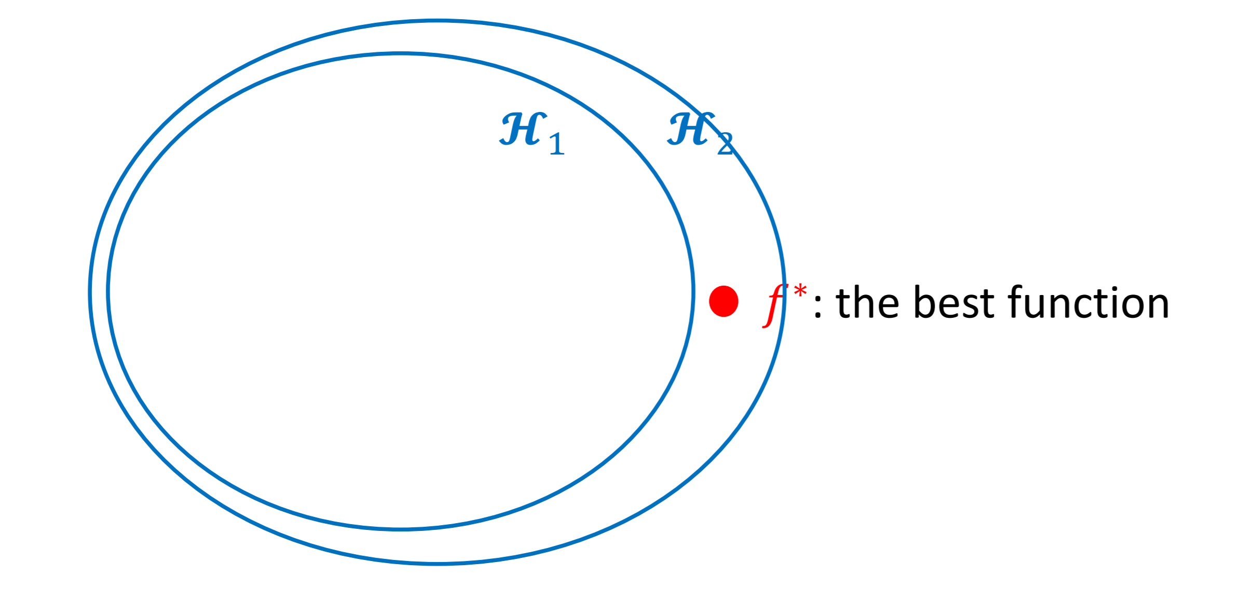
f* in or not in H
As you get more data, H₁ becomes H₂ and is more likely to encompass the actual model f*

Slide 19
Prior knowledge vs data?
Practical scenarios lie between the two extreme cases

Slide 20
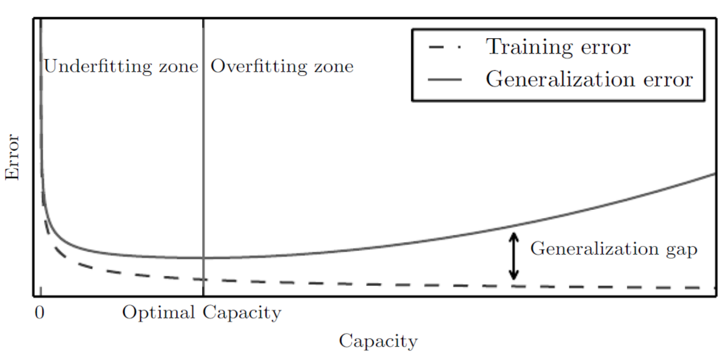
Prior knowledge vs data?

Slide 21
Optimal capacity
How do we select optimal capacity, for example, the best degree for polynomial curve fitting?
Cannot be done by training data alone (it will always look better to just overfit)
Solution is simple and easy to understand – cross validation

Slide 22
Cross validation
Partition your training data into several groups (number of groups varies, but usually at least 3)
Run your machine learning algorithm using all of the training data except for one of these groups
Then use the group that you left out as the “test set”
Then repeat but with a different group left out, etc., etc.

Slide 23
Cross validation
We will learn (many) other methods for dealing with how well models are working, but cross validation:
  Is general (you can almost always partition training data)
  Is simple
But…
  Is computationally expensive, especially when there are a lot of parameters to learn

